Slide 1

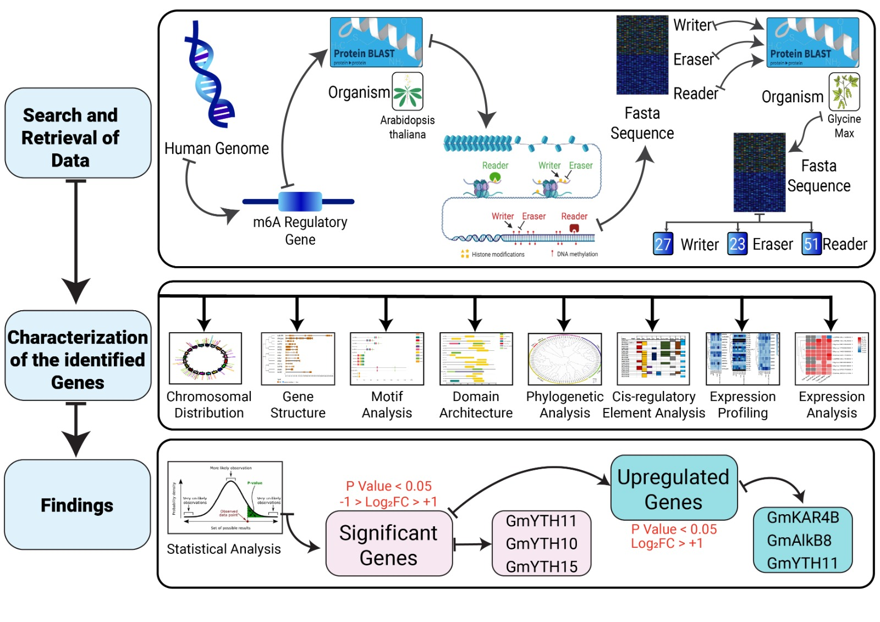
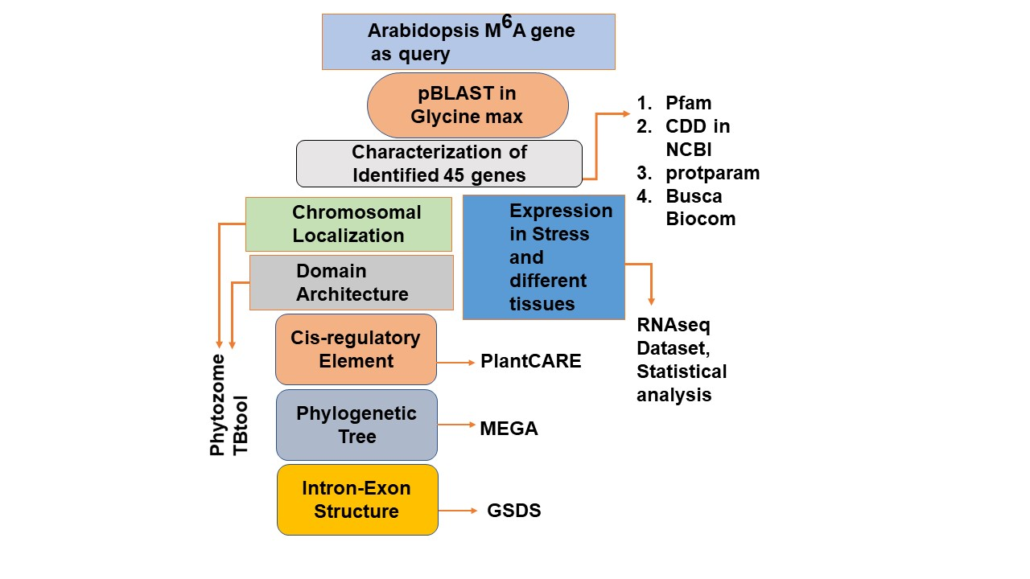
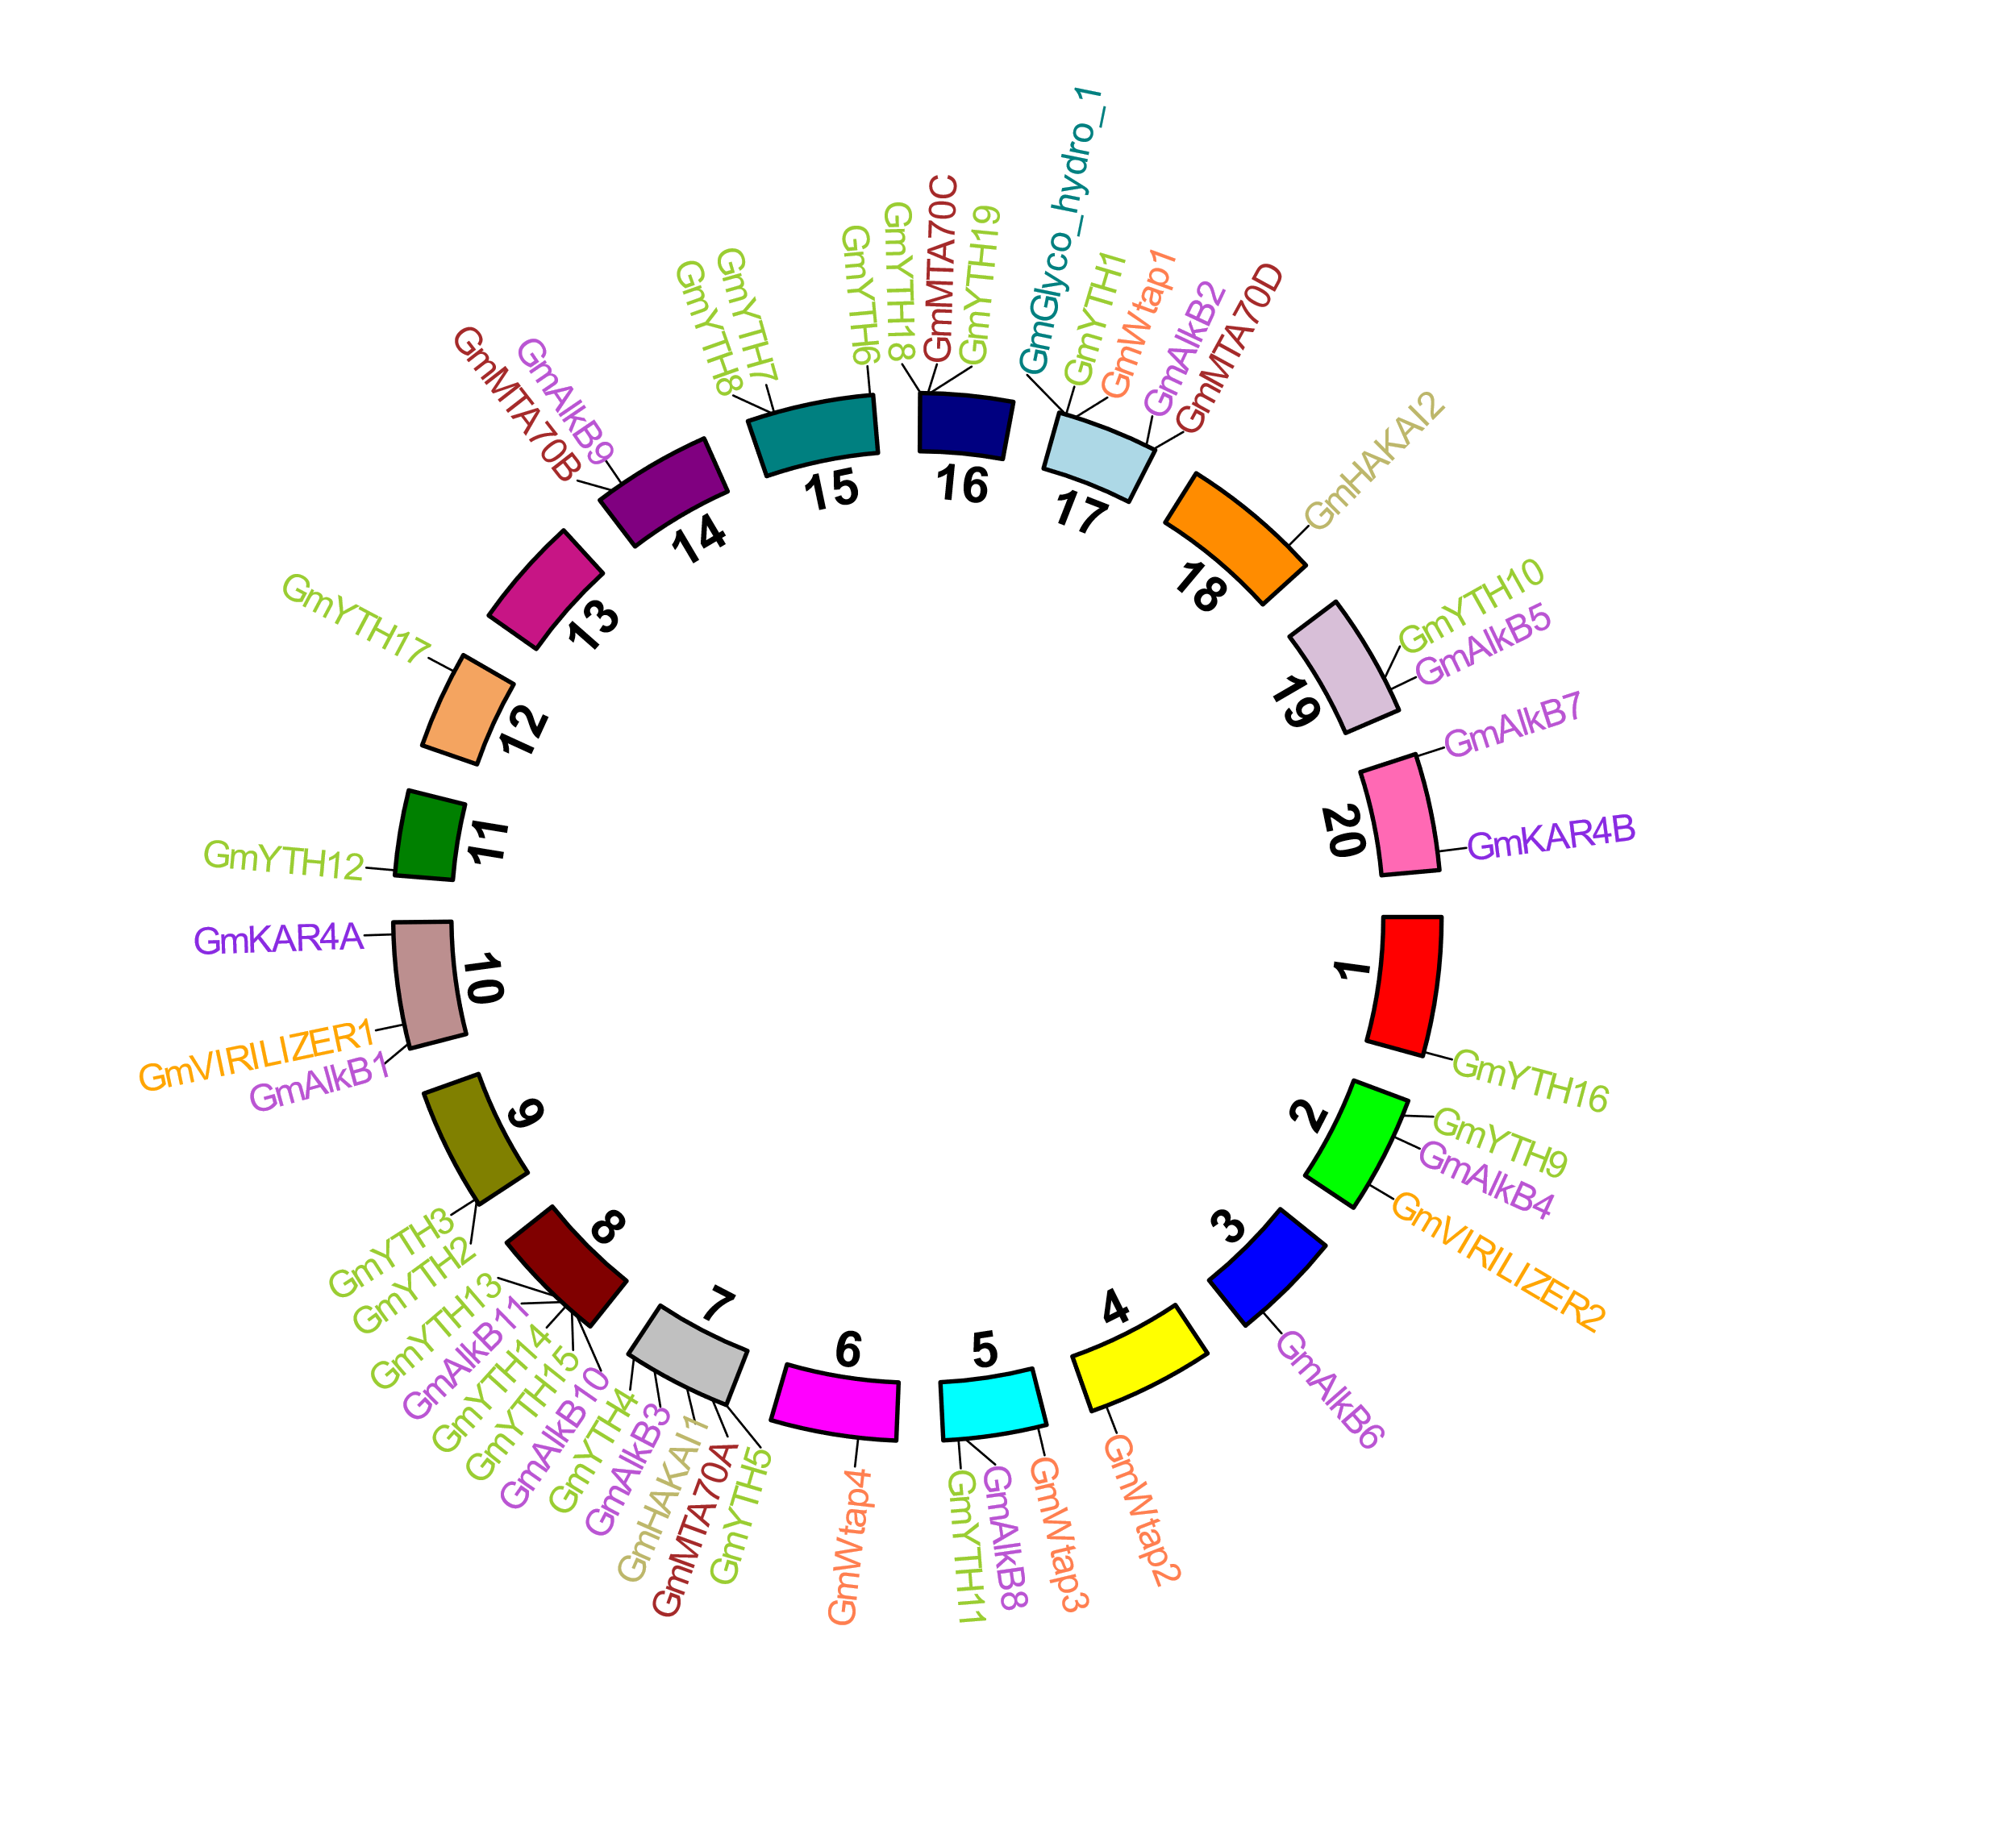
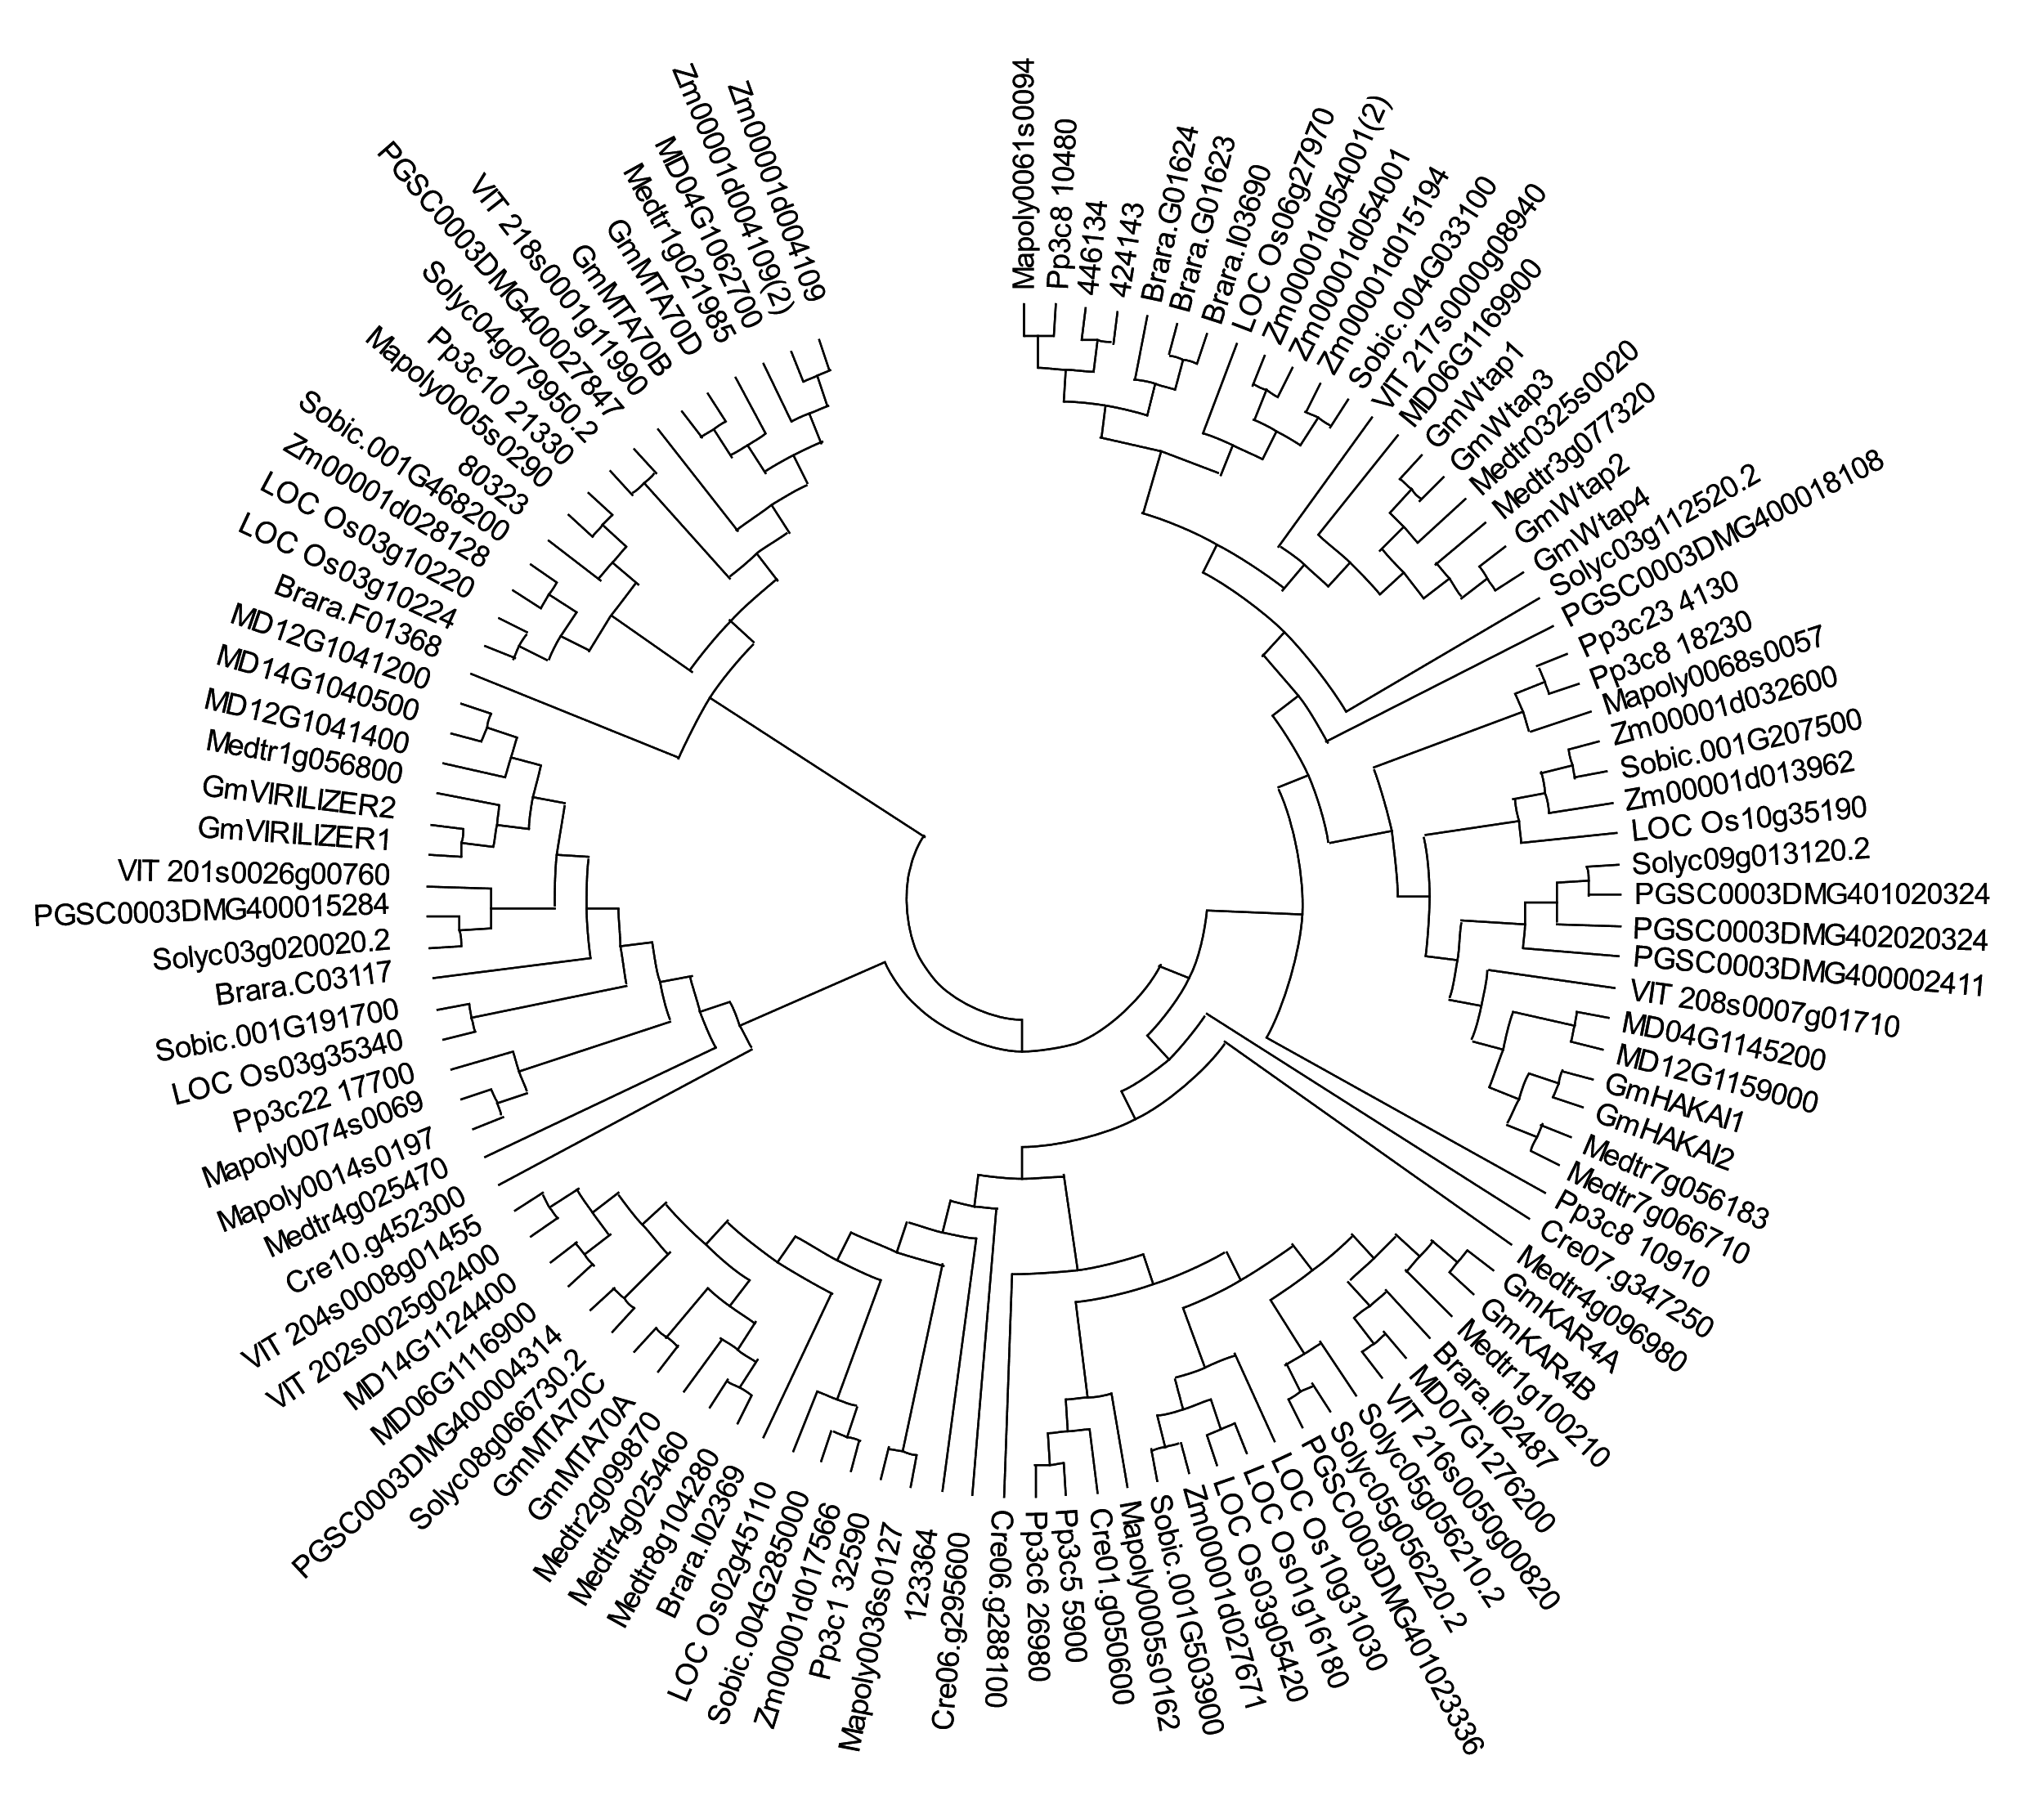
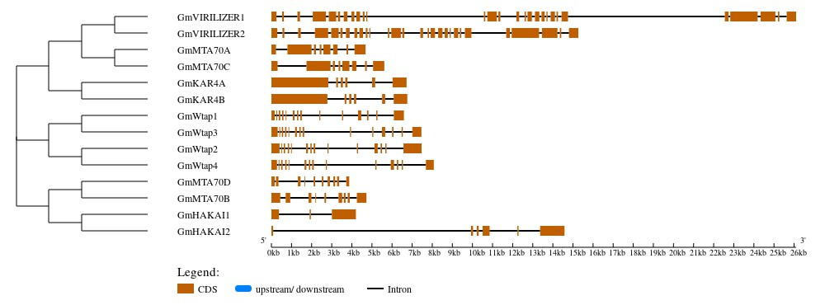
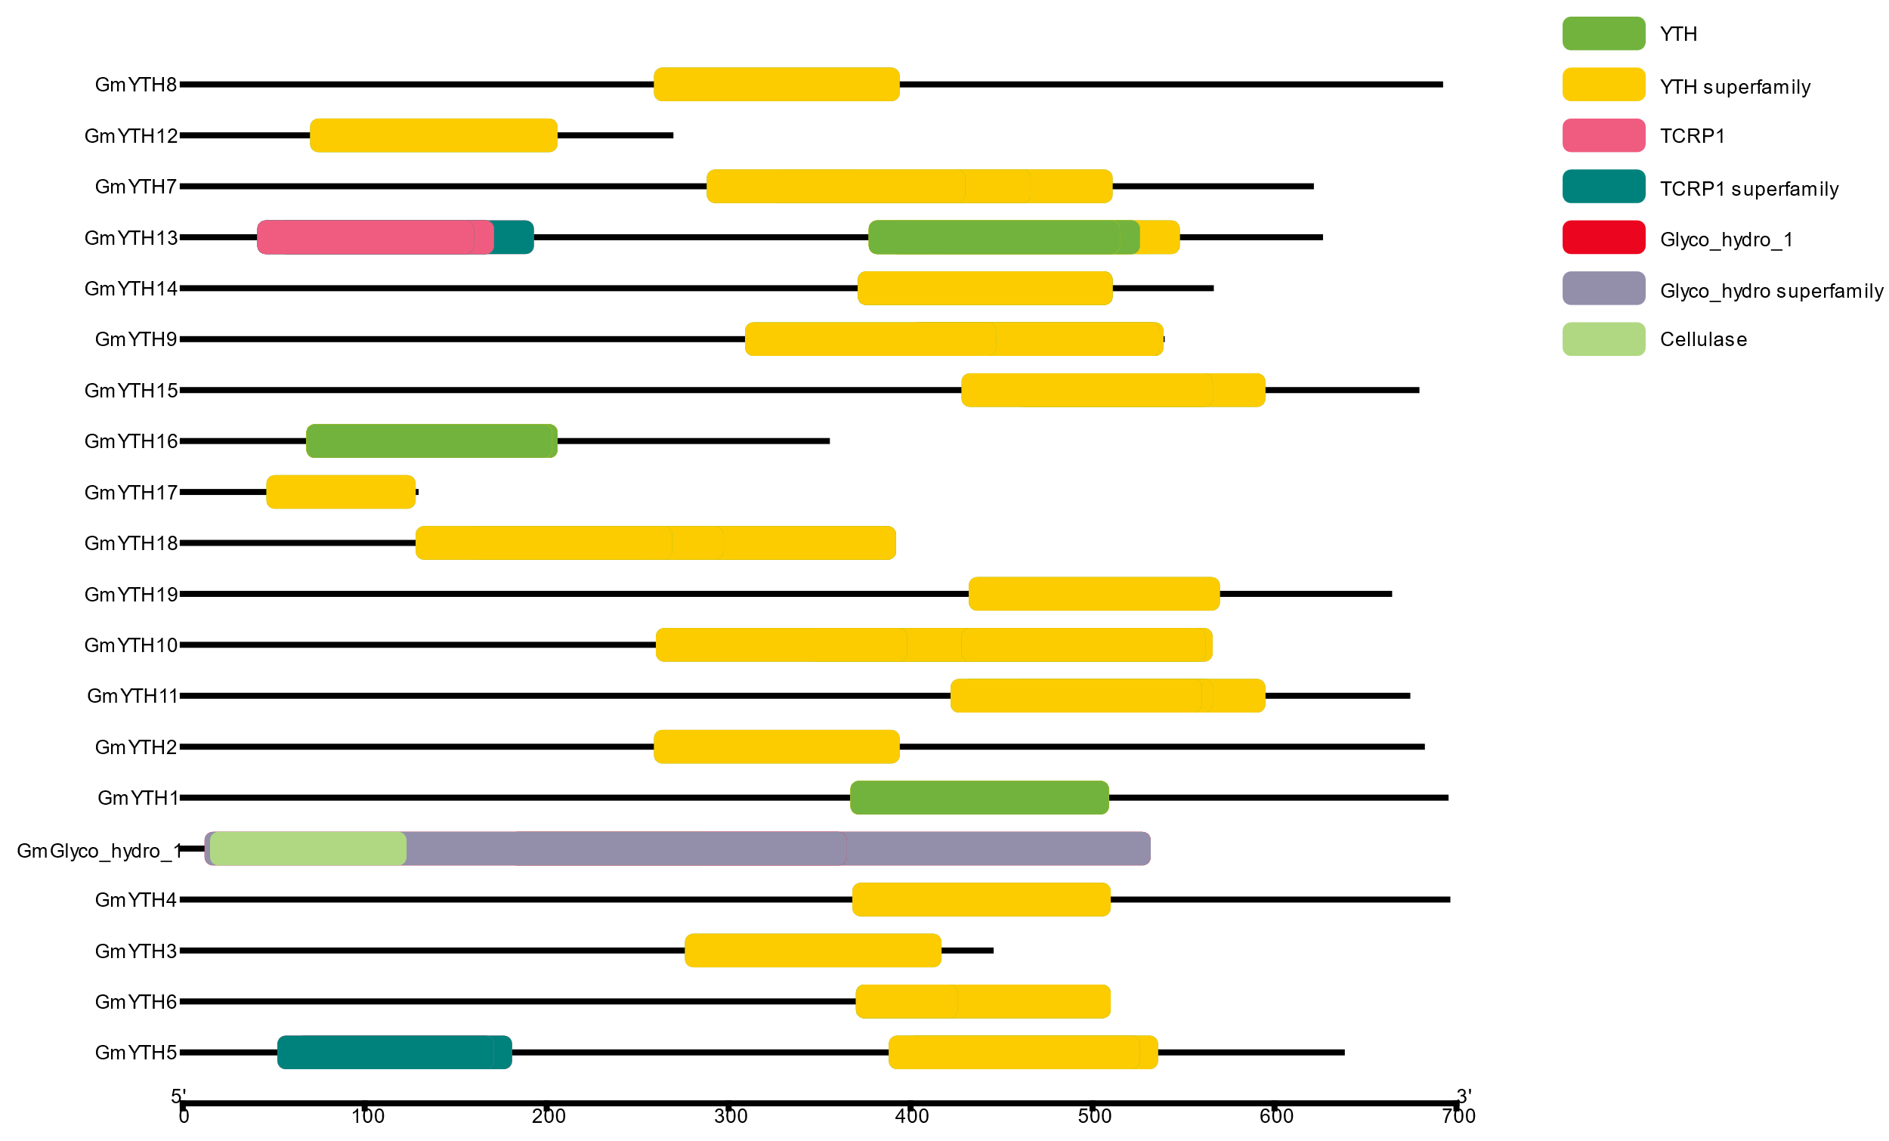
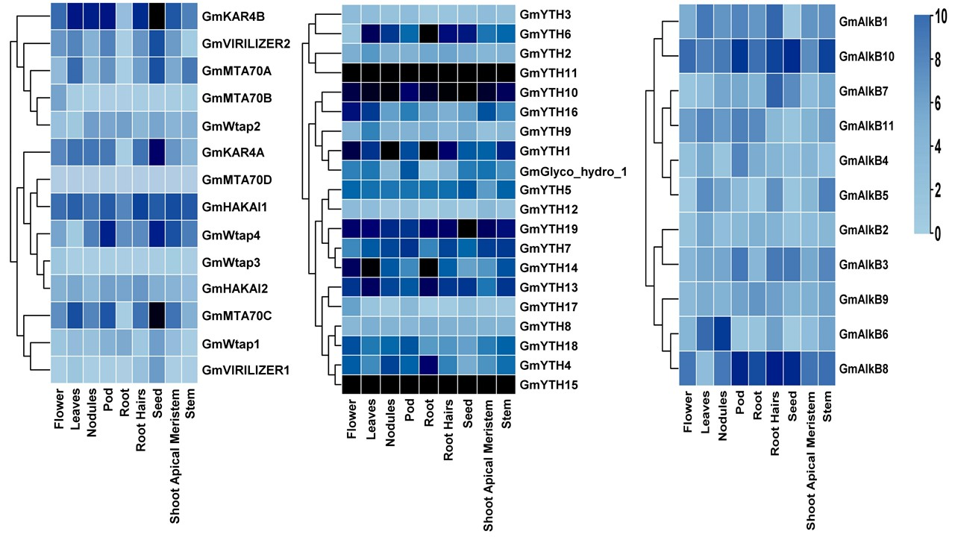
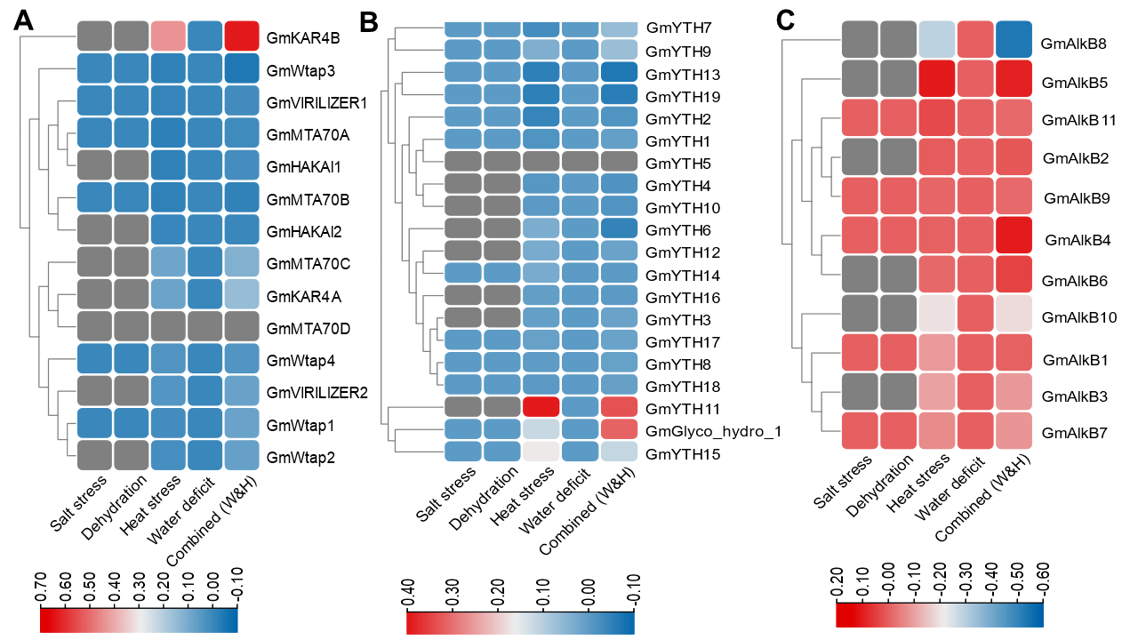

Comprehensive Genome-Wide Identification of Epitranscriptomic Methylation Marker Genes in Glycine Max, and Their Expression Profiling in Various Anatomical Tissues and Perturbation Conditions
Sabrina Bintay Sayed Registration no.: 2018433066, BSc session: 2018-19
Department of Biochemistry and Molecular Biology, Shahjalal University of Science and Technology, Sylhet-3114
Abstract
Method
Soybean (Glycine max) is one of the major vegetable protein and oil-producing legume plants. various environmental stresses could shorten the flowering and seed-filling periods of soybean, and thus accelerate senescence and reduce productivity. The available soybean genome database prompts us to identify novel stress-modulating genes.
Study Objectives
1.Results
This present study aims to identify m6A regulatory genes in Soybeans and their correlation with stress conditions.
2.Results
Exon-Intron Structure
Chromosomal Distribution
Phylogenetic Tree
3.Results
Expression in Tissues
Conserved Domain
Conclusion
Expression in Stress
1. A genome-wide identification of m6A regulatory genes has been
conducted in the soybean.
2. Detailed analysis of the identification genes, chromosomal location, phylogenic relationship, and presence of cis-regulatory elements have been performed.
3. Expression profiling in different anatomy has revealed the regular RNA methylation pattern in various plant tissues.
4. Glycine max’s stress tolerance pathway could be explored for molecular and functional characterization.
Amongst all the writer, reader, and eraser genes, GmYTH11, GmYTH10, and GmYTH15 have been significantly expressed in different tissues. Upregulation was observed in GmKAR4B, GmAlkB8, and GmYTH11 whenever heat and water treatments were combined. Regarding heat, salt, water deficiency, and water treatment, all the genes demonstrated downregulation.
Future Aspects
This study will encourage researchers to functionally validate and elucidate the molecular mechanism of plants utilizing RNA methylation in stress tolerance, thus, facilitating crop engineering.
Acknowledgment
Related Articles
Nishat, Z. S., Hasan, M. S., Islam, M. S., Hossain, T., & Ghosh, A. (2022). Identification of epitranscriptomic methylation marker genes in Arabidopsis and their expression profiling in response to developmental, anatomical, and environmental modulations. Current Plant Biology, 30(March), 100247. https://doi.org/10.1016/j.cpb.2022.100247

